Slide 1
HEPPP
(Health, Early Learning, Protection, Parenting Program)
evaluation research
Parenting support for refugee and vulnerable communities in Lebanon and Jordan during COVID-19 and a humanitarian crisis
Ghassan M. Issa, Muna E. Abbas, Lara C. Aoude, Grace J. Boutros, Asma S. Al Khatib, Sahar L. Matarneh, Dima M. AlFayez, Nael H. Alami and Najla A. Lakkis

Slide 2
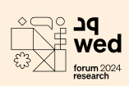
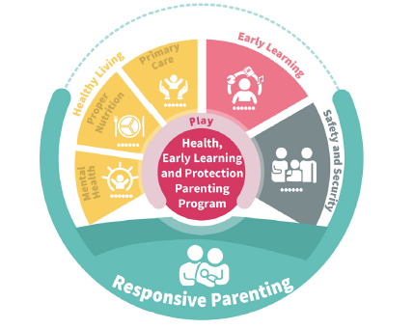
Introduction to HEPPP:
(Health, Early Learning, Protection, Parenting Program)
HEPPP:
Is an innovative, holistic, integrated, inclusive, and evidence-based program that supports Arabic-speaking parents in their journey from birth to age 8.
Responsive Parenting
(20 sessions)
Early Learning
(6 sessions)
Mental Health for Caregivers
(6 sessions)
Child Mental Health.
(6 sessions)
History:
Established in 2012, HEPPP has evolved over 12 years through implementations in Lebanon, Jordan, and Egypt, tailored for host and refugee communities.
Framework:
The program consists of 38 sessions across four key areas: responsive parenting, early learning, mental health for caregivers and child mental health.
The incubator:
A Holistic, integrated, and inclusive Playful approach to ECD

Slide 3
Introduction to HEPPP (health, early learning, protection, parenting program)
Digital Platform (Urjouha):
Provides additional resources, including age-specific advice, videos, and interactive content, while engaging parents through social media.
HEPPP is designed to be delivered in three modalities
Face to face modality
Online
modality
Blended modality
Father Engagement:
A priority since inception, adapting methods to encourage and support fathers in active parenting.
Incorporates best practices to engage fathers and males
Delivered to fathers and mothers together
Continuously revisited, updated, and complimented with new content on Urjouha
Global Relevance:
While HEPPP is designed for multi-crisis contexts, its principles apply broadly for early childhood development and parental support worldwide.
www.urjouha.net

Slide 4
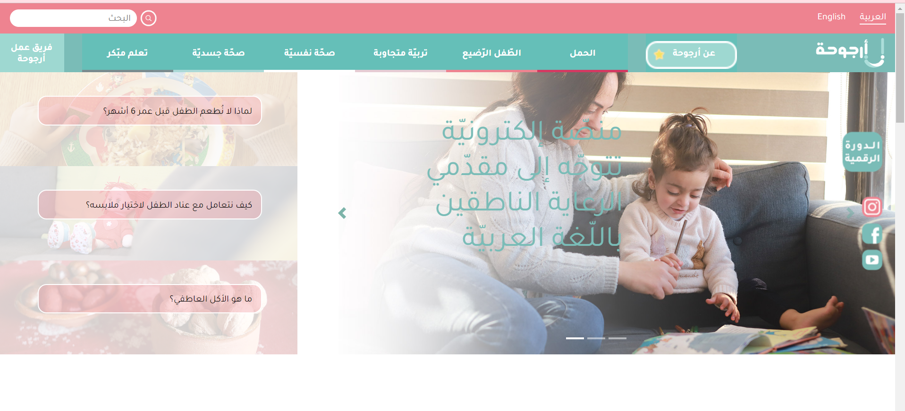
TEXT HERE
www.urjouha.net

Slide 5
Research Objectives of HEPPP
1. Assess the effectiveness of the HEPPP model in enhancing parenting knowledge, behaviors, and practices, with a focus on refugee and vulnerable communities in Lebanon and Jordan, particularly during crises (Syrian refugee crisis and COVID-19 pandemic).
2. Evaluate delivery modalities (face-to-face, online, hybrid) to identify the most effective methods for program implementation in crisis contexts.
2019-2021
3. Measure the psychosocial well-being of parents and children to determine if HEPPP positively influences mental and emotional health for both groups.

Slide 6
Research Methodology
Research design:
Adapted from rct to pre- and post-intervention study with three cohorts:
Group 1: face-to-face delivery by parent-trained mentors.
Group 2: face-to-face delivery by master-trainer mentors.
Group 3: online delivery by a mix of mentor types.
Mixed-methods approach
Participants:
Involved refugee families (Syrian and Palestinian) and vulnerable host communities in Lebanon and Jordan, including mothers, fathers, and caregivers of children aged 0-8.

Slide 7
Research Methodology
A combination of standardized tools like the: WHO-5 Well-being Index, Parenting Stress Index-Short Form (PSI-SF), Strengths and Difficulties Questionnaire (SDQ), and locally validated instruments.
Pre- and post-intervention measurements for parenting behaviors and psychosocial well-being.
Focus group discussions (fgds) and key informant interviews (kiis) conducted virtually due to pandemic constraints.
Data Collection Tools
Qualitative data:

Slide 8
Key Findings
The research yielded several significant findings:
Positive impact on parenting knowledge and behaviors across all cohorts.
Increased participation from fathers: for the online modality due to the flexibility and accessibility benefits of digital formats.
Psychosocial well-being improvements: parents reported lower levels of stress and improved psychosocial well-being more with f2f modality.

Slide 9
success and challenges
The original RCT design was not fully realized due to difficulties in maintaining a control group and the logistical constraints of conducting research during multiple crises.
challenges
success
Potential for scale and hybrid models
The potential of online and hybrid models to be more cost-efficient and effectiveness

Slide 10
unique about HEPPP research process and HEPPP
Incorporating Fathers into Parenting Prorams
Incorporating Fathers into Parenting Programs
Incorporating Fathers into Parenting Programs
Crisis management and adaptability
Cultural sensitivity and local expertise
Engagement of fathers in parenting programs
Leveraging local networks and community engagement
Psychosocial support integration
Incorporating Fathers into Parenting Programs
Incorporating Fathers into Parenting Programs
Incorporating Fathers into Parenting Programs
01
02
03
Flexible research methodology for crisis contexts
Inclusivity and flexibility in program delivery
Utilization of digital platforms

Slide 11
Networking Roles in the HEPPP Research
Collaboration with local and international partners
Involved key organizations: Arab resource collective (ARC), plan international Jordan, American university of Beirut (AUB), and modern university for business and science (MUBS).
Partner name | Role of partners
ARC | led program management and curriculum development across Lebanon and Jordan.
Plan international Jordan | key implementer for Syrian and other refugee populations, working to ensure cultural appropriateness
Aub | provided research design and technical support.
MUBS | Conducted on-the-ground data collection, critical for program adaptation
Community-Based Organization (CBO) Engagement
CBOs and municipalities facilitated program implementation in refugee camps and vulnerable areas:
Lebanon: Reached Syrian and Palestinian refugees in Bayssour and Bourj Al Barajneh camps.
Jordan: Delivered programs in Azraq refugee camp.
CBOs were essential for recruiting participants and ensuring the program's cultural relevance.

Slide 12
Expanding HEPPP through Strategic Partnerships
HEPPP research is the gateway for expansion of the national and regional partnership.
It’s the foundation of a national team, scalability and regional adaptation, advancing regional research.
HEPPP create the vision for Sustainable Impact by create a sustainable framework for supporting vulnerable families across diverse regions.

Slide 13
ورشة الموارد العربيّة Arab Resource Collective
(www.facebook.com/ArabResourceCollective)
www.mawared.org
Arab Network for Early Childhood - ANECD - الشبكة العربية للطفولة المبكرة
(www.facebook.com/ArabNetworkECD)
Arab Network for Early Childhood ANECD
ANECD1 (www.twitter.com/ANECD1)
www.anecd.net

